Slide 1
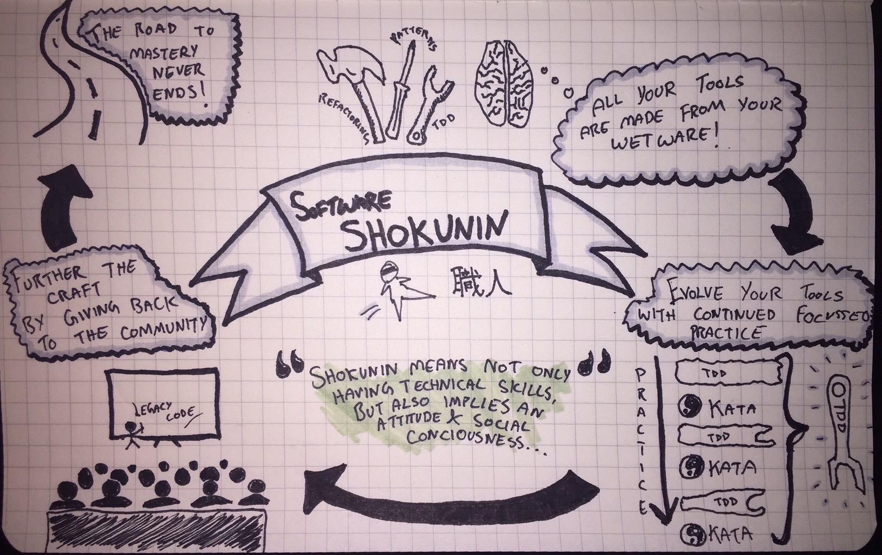
Shokunin Sessions
Refactoring Legacy Code
Notes:
Welcome!
question: who here looks back at their TW recruitment assignment and thinks it was awesome?

Slide 2
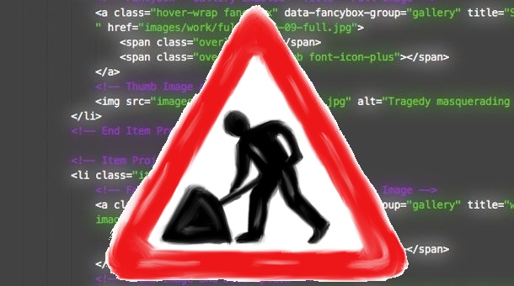
Legacy Code
“To me, legacy code is simply code without tests”
Michael Feathers
Notes:
What’s the context?
any code that is difficult to change
difficult to understand
anything that ‘smells’
“Legacy code is valuable code that we feel afraid to change”

Slide 3
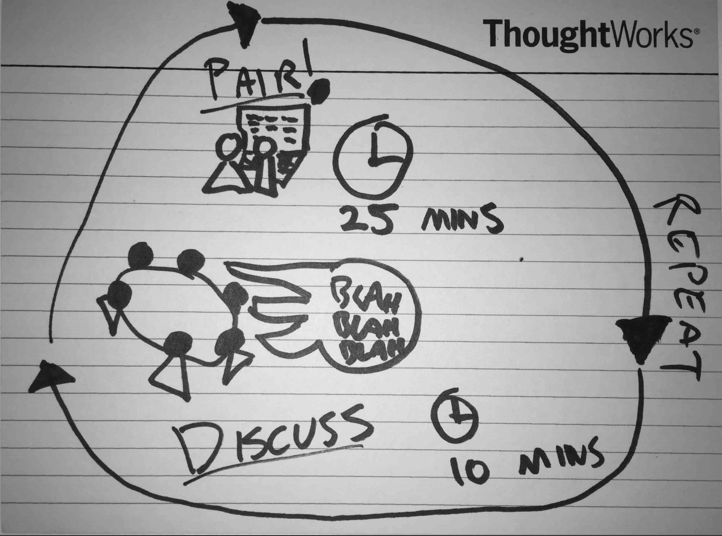
Today’s Agenda
Ruby
Java
Javascript
Notes:
first round is a free for all
introduce a concept in between each round
switch pairs each round
change languages each round
reflect after each round and see what we learned (if anything!)

Slide 4

Notes:
- Need to go over some ground rules which we expect everyone to abide by

Slide 5

Notes:
Be Present
Pair properly (no extra screens)
Turn phones to silent
We’re practicing our pairing as much as our development

Slide 6

“ Empty your cup so that it may be filled; become devoid to gain totality ”
Notes:
2. Clear your mind
We’re here to learn from each other
We’re seeking different perspectives
Opinions are OK, as long as they’re weakly held

Slide 7
Everyone is Equal
Even Adam

Slide 8
Failure is Encouraged
As long as you learn from it

Slide 9
Get into pairs!
Notes:
Give them a minute...

Slide 10
Round 1
Ruby
Notes:
use the ruby development environment provided
use a pairing pattern you’re comfortable with (ping / pong, driver / navigator)
25 minutes on the clock… GO

Slide 11
Trivia Codebase: the obvious
It’s a trivia game
Example has 3 players
There is the concept of rolling dice
There is the concept of player location (on a board?)
There are different categories of question
Users answer questions
Correct answers earn players gold
Wrong answers send players to the penalty box
There is a way for players to get out of the penalty box
It looks like the first user to reach 6 gold coins wins

Slide 12
Reflect
Notes:
timebox for 5 minutes
get at least one person from each pair
stop debate, there will be time for it later

Slide 13
Golden Master
Find the way the system delivers its outputs
Find a way to capture the output of the system without changing the code
Find a pattern for the outputs
Generate enough random inputs and persist the input / output
Write a system test to check the SUT against the previously persisted data
Commit the test
Check test behaviour and coverage
If not enough behaviours are covered, go to step 3
Notes:
Our clients write code we will work with everyday
They frequently write it without tests
Golden master is a way of capturing a system’s current behaviour without changing production code in order to make sure our initial refactorings don’t change that behaviour
Stored procedure example

Slide 14
Get into pairs!

Slide 15
Round 2
Java

Slide 16
http://bit.ly/gldnmstr
Notes:
location of a golden master for Java
don’t forget to seed the gamerunner - hardcode it to whatever you want, the higher it is the bigger the scope for a game...

Slide 17
Reflect

Slide 18
Seams
A way of altering behaviour of code without touching the production code
Types:
Preprocessor
Link
Object (dependency injection or subclass and override)
We can also modify prototypes in javascript - create new method definitions on the fly
Notes:
Sometimes code is tightly coupled to external systems
Need a way of decoupling the code - one technique is seams
Seam is a way to alter behaviour of a program without editing in that place (overrides & mocks!)
preprocessor seams / link seams / object seams...

Slide 19
Get into pairs!

Slide 20
Round 3
Javascript

Slide 21
http://bit.ly/gldnmstr
Notes:
location of a javascript seam gist

Slide 22
Reflect

Slide 23
Retro

